Slide 1

Chapter 6 – S7
How to use CSS for page layout
Notes:
Session: Ghi số thứ tự session trong môn học
Session Name: ghi tên của session sẽ dạy

Slide 2
Objectives
How to float elements in 2- and 3-column layouts
Two web pages that use a 2-column, fixed-width layout
How to use CSS3 to create text columns
How to position elements
Notes:
Mô tả nội dung mà học viên phải đạt được khi kết thúc môn học này

Slide 3
How to float elements in 2 and 3 column layouts
Notes:
Mô tả nội dung chi tiết từng chuyên đề

Slide 4
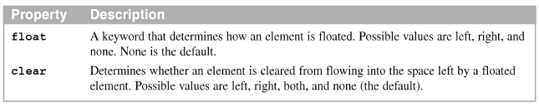
How to float and clear elements
Float and element to the right or left, the content that follows flows around it.
The properties for floating and clearing elements
Notes:
Mô tả nội dung chi tiết từng chuyên đề

Slide 5
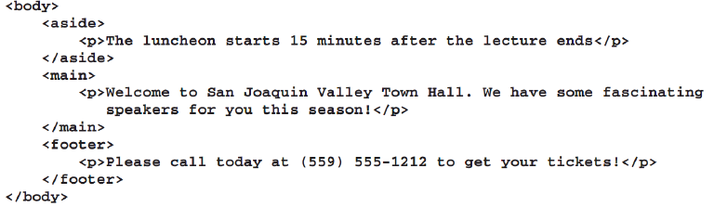
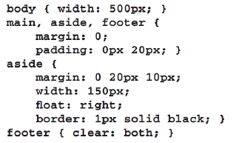
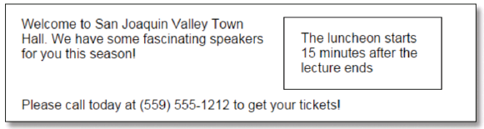
Example
HTML code
CSS code
Result

Slide 6
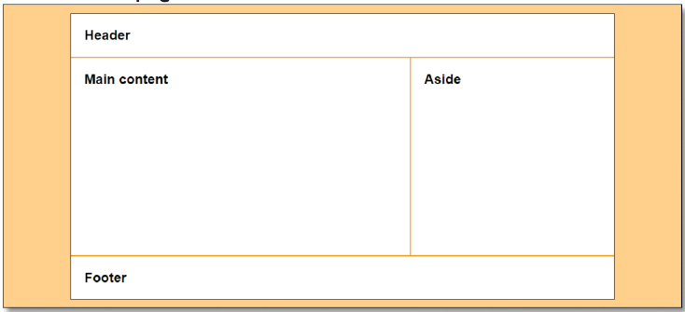
How to use floating in a 2-column, fixed-width layout
A 2-column web page width page fixed-width columns

Slide 7
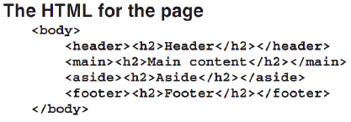
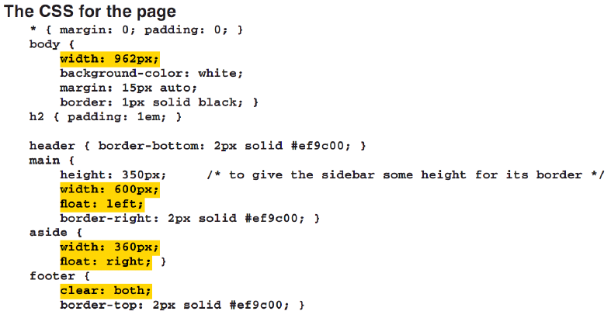
How to use floating in a 2-column, fixed-width layout (cont.)

Slide 8
How to use floating in a 2-column, liquid layout
The benefit of using liquid column sizes is that the size of the page is adjusted to the resolution of the browser
The disadvantage is that changing the size of the columns may affect the typography or the appearance of the page

Slide 9
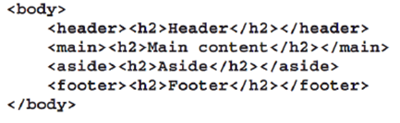
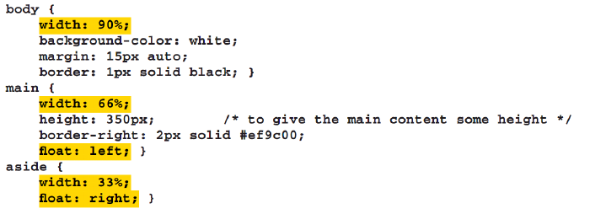
How to use floating in a 2-column, liquid layout (cont.)
HTML code
CSS code

Slide 10
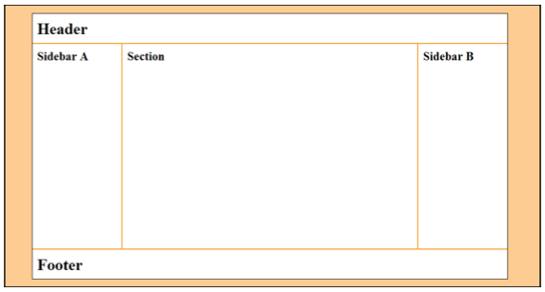
How to use floating in a 3-column, fixed-width layout
The first aside is floated to the left; the section is floated to the left; and the second aside is floated to the right
A 3-column web page with fixed-width columns

Slide 11
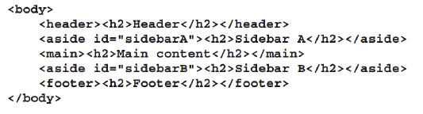
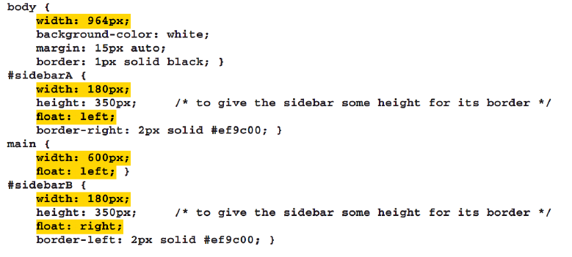
Example
HTML code
CSS code

Slide 12
Two web pages that use a 2-column, fixed-width layout

Slide 13

The home page
A home page with a sidebar floated to the right of a section

Slide 14
The HTML for the home page
The HTML for the home page (index.html)

Slide 15
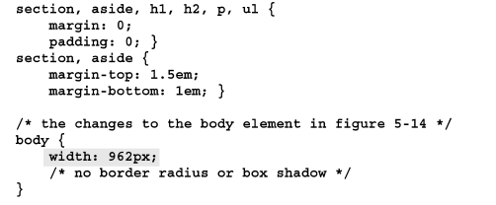
The CSS for the home page
The CSS for the home page (main.css)
…..

Slide 16

The speaker page
A speaker page with a sidebar floated to the right of an article

Slide 17
The CSS for the speaker page
article, aside, h1, h2, p ul {
margin:0 ;
padding:0; }
article, aside {
margin-top: 1.5em;
margin-bottom: 1em;}
/* the stype for the article */
article {
width: 580px;
border-right: 2px solid #ef9c00;
padding-right: 20px;
float: right; }
article h1 {
margin-bottom: .35em;}
article img {
float: left;
margin: 0 1.5em 1em 0;}

Slide 18
How to use CSS3 to create text columns

Slide 19
The CSS3 properties for creating text column
At this writing, only Opera supports these properties in their native form. Firefox requires the –moz- prefix, Chrome and Safari require the –webkit- prefix, and IE provides no support for these properties.

Slide 20
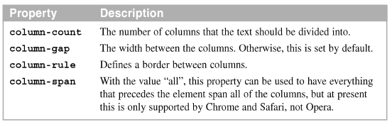
The primary CSS3 properties for creating text columns

Slide 21

The columns width 25px gaps and 2px rules in a browser window

Slide 22

A 2-column web page with a 2-column article
The CSS for creating the columns
The web page with a two-column article

Slide 23
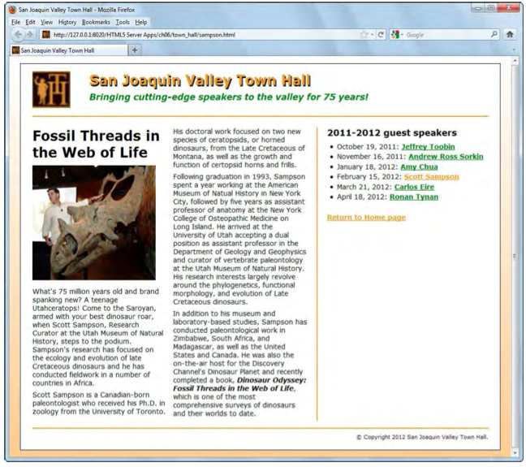

Slide 24
How to position elements

Slide 25
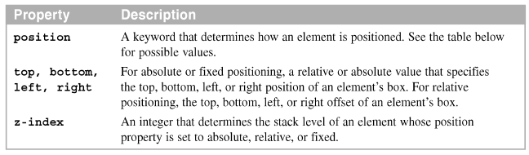
Four ways to position an elements
By default, static position is used to position block elements from top to bottom and inline elements from left to right
Properties for position elements

Slide 26
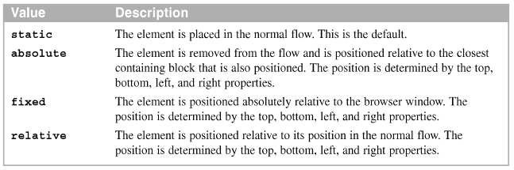
Four ways to position an elements(cont.)
Possible value for the position property

Slide 27
How to use fixed positioning
Use absolute positioning, the remaining elements on the page are positioned as if the element weren’t there.
Use fixed positioning for an element, the positioning applies to the browser window and the element doesn’t move even.
The web page with absolute positioning in a browser

Slide 28
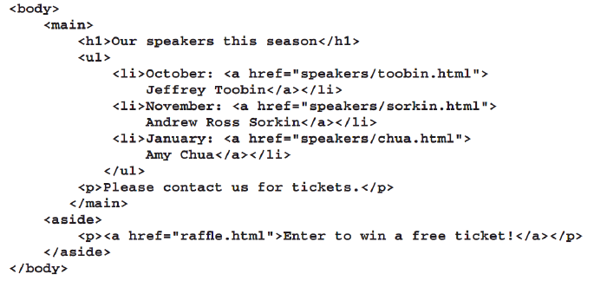
How to use fixed positioning -Example
HTML code

Slide 29
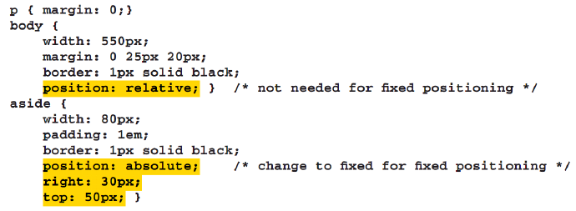
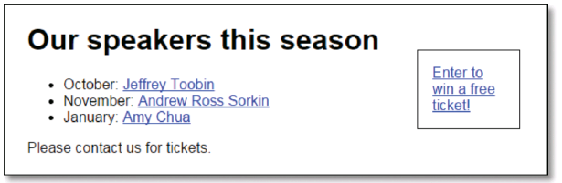
How to use fixed positioning -Example
CSS code

Slide 30
Summary
Use the float property an element, any element
In a fixed layout, the widths of the column are set. In a liquid layout, the width of the page and the width of at least one column change as the user changes the width
Use absolute positioning for a elements
Use relative positioning for an element, the remaining elements leave space for the moved element
Use fixed positioning for an element
Notes:
Tóm tắt lại nội dung đã học

